Slide 1
Spiral Model

Slide 2
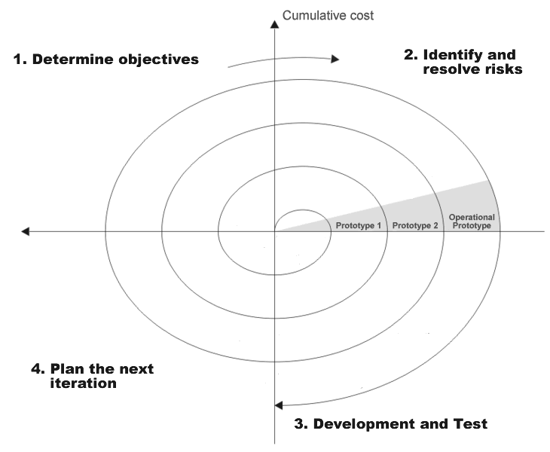

Slide 3
Spiral model uses a prototyping approach by first building a
prototype before embarking on actual project development effort.
This model can be considered as a supporting model for evolutionary
model.
The iterations along the spiral can be considered as evolutionary levels
through which the complete system is built.
Spiral Model is a model with several loops where the no. of loops are
not fixed.
Each phase in this model is split into four sectors.

Slide 4
The first quadrant identifies the objectives of the phase and the alternative solutions possible for the phase under consideration.
The second quadrant, signifies the alternative solutions to be evaluated to select the best possible solution.
In the second quadrant, potential risks are also identified for the chosen solution.
In the third quadrant, development and verification of the next level of the product is done.
In the fourth quadrant, the results of various stages traversed so far are reviewed and planning of the next iteration around the spiral is done.

Slide 5
With each iteration around the spiral(beginning at the centre and
moving outwards), progressively a more complete version of the
software gets built.
Usually, after several iterations along the spiral, all risks are resolved
and the software is ready for development.
At this point, waterfall model of software development is adopted.
The radius of the spiral at any point represents the cost incurred in the
project till then.
The angular dimension represents the progress made in the current
phase.
In the spiral model of development, the project team must decide how
exactly to structure the project into phases.

Slide 6
ADVANTAGES
Most distinguishing feature of this model is the ability to handle risks.
Risk handling is specifically included in each phase of this model.
During each iteration , risk analysis through prototype construction
allows weighing different alternatives available to handle the risks.
The spiral model uses prototyping as a risk reduction mechanism and
also retains the systematic step wise approach of the waterfall model.
Highly useful for bigger projects, where risk factors are high.

Slide 7
PROBLEMS
This model is much more complex than other models, as a result of
which it cannot be used in ordinary and small projects.

